Slide 1
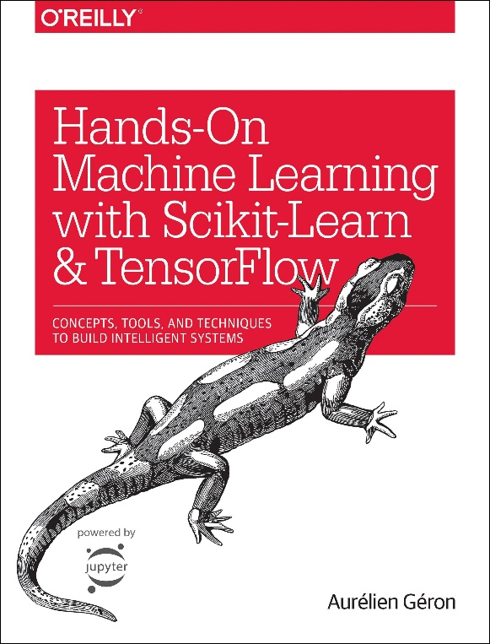
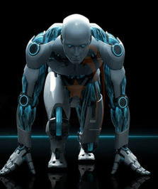
Novice Machine Learning E2E Project
Part 09
Custom Transformers
Mukunthan Ragavan

Slide 2
E2E Machine Learning Project
Look at the Big picture.
Get the Data (Split the Data, Stratifying the Data).
Discover and visualize the data to get insights.
(Scatter with plot with density and color map, Correlation)
Prepare the data for ML algorithms. (Data Cleaning, One Hot Encoding, Custom Transformers)
Select a model to train it.
Fine-tune your model.
Present your solution.
Launch, monitor and maintain your system.

Slide 3
Writing our own transformers using by implementing three methods: fit(), (returning self), transform(), and fit_transform(). fit_transform() will be inherited from TransformerMixin. Adding BaseEstimator as a base class we will get two extra methods (get_params() and set_params())

Slide 4
Coding in action !

Slide 5
Thanks All for watching and your subscription !

